Slide 1

Architecture Analysis
Chapter 8

Slide 2
8 – Architecture Analysis
8.1 Analysis Techniques
8.2 Quantitative Analysis
  8.2.1 Performance Views
  8.2.2 Performance Analysis Techniques for Architectures
  8.2.3 Quantitative Modelling
  8.2.4 Quantitative Analysis Technique
8.3 Functional Analysis
  8.3.1 Static Analysis
  8.3.2 Dynamic Analysis
8.4 Summary

Slide 3
8 – Architecture Analysis
In this chapter we argue that whenever a change in the enterprise architecture is needed, model-based analysis plays a central role.
Therefore, we present a number of techniques that help architects and stakeholders to compare alternative designs and, hence, take well-informed design decisions when making trade-offs between aspects like cost, quality, and performance and to be able to study the impact of a change to the design.

Slide 4
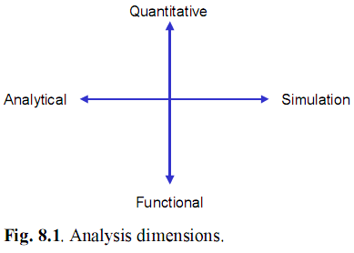
8.1 Analysis Techniques
We can classify architecture analysis techniques according to different aspects

Slide 5
First, we make a distinction based on the types of analysis inputs and results: functional (e.g., structural and dynamic properties) and quantitative (e.g., performance and costs).
Second, for both functional and quantitative analysis, we distinguish two main types of techniques: analytical techniques and simulation.

Slide 6
8.2 Quantitative Analysis
As noted earlier, enterprise architecture is concerned with a description of how all the relevant elements that make up an enterprise interrelate. It covers aspects ranging from business processes and products, through software applications, to the technical infrastructure
Quantitative analysis can serve several purposes. In the first place it is often used for the optimisation of, for example, processes or systems, by quantifying the effect of alternative design choices.

Slide 7
Models of organisations and systems can be quantified in several ways.
Measures of interest may include:
  Performance measures, i.e., time-related measures such as completion and response times, throughputs, resource utilisations.
  Reliability measures such as availability and dependability.
  Cost measures.

Slide 8
8.2.1 Performance Views
As explained earlier, the different ways to structure an enterprise architecture model provide different views of the same model.
These views are aimed at different stakeholders and their concerns. Each having their own performance measures, explained below:

Slide 9
  User/customer view (stakeholders: customer; user of an application or system): The response time is the time between issuing a request and receiving the result
  Process view (stakeholders: process owner; operational manager): Completion time is the time required to complete one instance of a process (possibly involving multiple customers, orders, products, etc., as opposed to the response time, which is defined as the time to complete one request).

Slide 10
  Product view (stakeholders: product manager; operational manager): Processing time is the amount of time that actual work is performed on the realisation of a certain product or result
  System view (stakeholders: system owner/manager): Throughput is the number of transactions or requests that a system completes per time unit
  Resource view (stakeholders: resource manager; capacity planner): Utilisation is the percentage of the operational time that a resource is busy.

Slide 11
8.2.2 Performance Analysis Techniques for Architectures
Although several software tools exist to model enterprise architectures, hardly any attention has been paid to the analysis of their quantitative aspects.
Enterprise architecture covers a broad range of aspects, from the technical infrastructure layer (e.g., computer hardware and networks), through software applications running on top of the infrastructure, to business processes supported by these applications

Slide 12
We also noted earlier that enterprise architecture is specifically concerned with the relations between the layers.
  Infrastructure Layer : Traditionally, approaches to performance evaluation of computer systems and communication systems have a strong focus on the infrastructure domain.
  Application Layer : Performance engineering of software applications (see Smith 1990) is a much newer discipline compared to the traditional techniques described above.

Slide 13
  Business Layer : Several business process modelling tools provide some support for quantitative analysis through discrete-event simulation. A drawback of simulation is that it requires detailed input data, and for inexperienced users it may be difficult to use and to interpret the results correctly.

Slide 14
8.2.3 Quantitative Modelling
In this section we present our approach for the quantitative modelling of service-oriented enterprise architectures expressed in the ArchiMate language.
We also introduce an example that shows how quantitative information can be attached to model elements and their relations and that will later also illustrate the application of the algorithms.

Slide 15
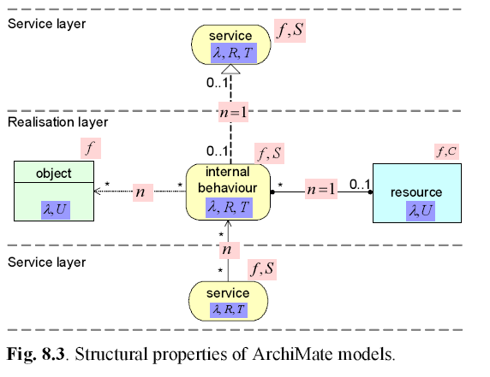
Model Structure

Slide 16
We can summarise our findings in terms of the ‘analysis metamodel’ depicted in Fig. 8.3, where :
  ‘object’ can be a business object, a data object, or an artifact;
  ‘resource’ can be a business role, a business actor, an application component, a system software component, a node, or a device;
  ‘internal behaviour’ can be a business process, a business function, an application function, or an infrastructure function;
  ‘service’ can be an organisational service, an application service, or an infrastructure service.

Slide 17
Approach
  Analysis across an architecture model is possible through the propagation of quantities through layers. A natural option for this is to consider workload measures (e.g., arrival frequencies) that are imposed as a ‘demand’ on the model elements by the users (located in the higher layers, e.g., customers).

Slide 18
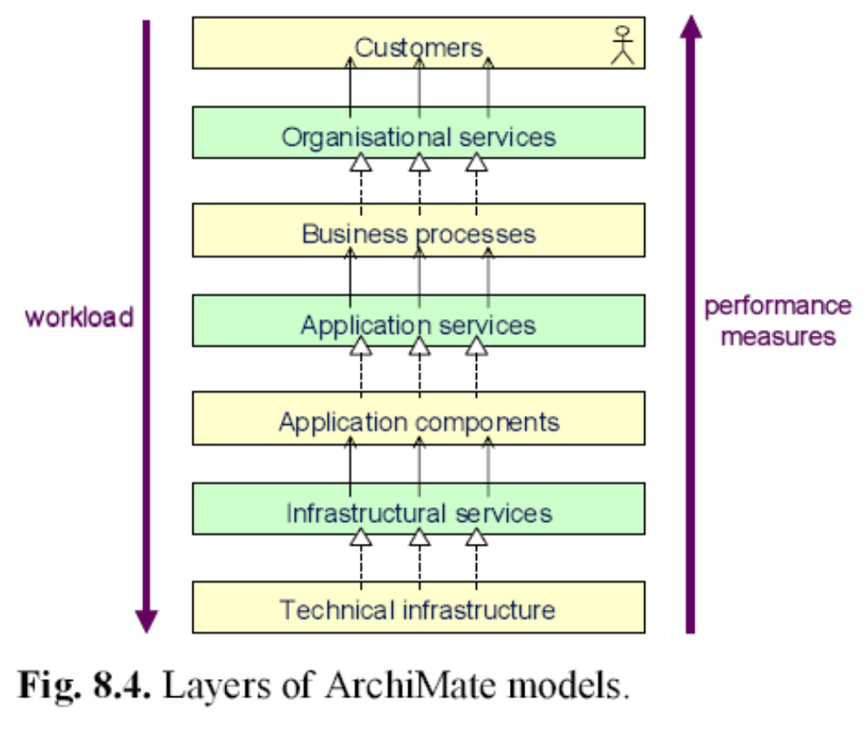

Slide 19
Quantitative Input Data
  One of the most difficult tasks related to quantitative analysis is to obtain reliable input data. There are several possible sources for this data.
  For existing systems or organisations, measurement can be one of the most reliable methods, although it is not easy to do this in a correct way: among others, it should be clearly defined what exactly is to be measured, the number of measurements must be sufficient, and the measurements must be taken under various circumstances that can occur in practice.

Slide 20
8.2.4 Quantitative Analysis Technique
The goal of our approach is to determine the following performance measures
  the workload (arrival rate) a λ for each node a (note that, provided that no resources are overloaded, the throughput for each node is equal to its arrival rate);
  the processing time a T and the response time a R , for each behaviour element or service;
  the utilisation r U , for each resource r.

Slide 21
To derive the above-mentioned performance measures, given the input values, we proceed in three steps:
  We will first ‘normalise’ any input model, using model transformations, in order to generate a model that is compliant with the structure presented in Fig. 8.3.
  Top-down calculation of workloads (arrival rates) λ.
  Bottom-up computation of performance measures T, U, and R.

Slide 22
8.3 Functional Analysis
In functional analysis of architectures, we distinguish between static or structural and dynamic or behavioural aspects. For analysing the static structure of an architecture, its signature forms the basis.
For the logical analysis of the dynamics of an architecture, the formal semantics of a symbolic model of that architecture provides a formal basis.
A signature of an architecture only specifies the basic concepts with which the architecture is described, but an interpretation contains much more detail.

Slide 23
8.3.1 Static Analysis
For structural analysis of architectures, description logics are useful formalisms. Description logics are knowledge representation languages tailored to express knowledge about concepts and concept hierarchies.
They are considered an important formalism unifying and giving a logical basis to the well-known traditions of frame-based systems, semantic networks, and KL-ONE-like languages (Woods et al. 1992), object-oriented repreFunctional Analysis 211 sentations, semantic data models, and type systems.

Slide 24
8.3.2 Dynamic Analysis
For dynamic analysis of architectures, functional analysis techniques based on formal approaches such as process algebras and data flow networks are useful. Issues like two roles acting at the same time, overwriting or destroying each other’s work, can be identified and then a suitable protocol can be designed to prevent the problem.
Thus, a functional behaviour analysis based on formal methods is primarily a qualitative analysis that can detect logical errors, leads to a better consistency, and focuses on the logic of models

Slide 25
8.4 Summary
In this chapter we have considered the relation between enterprise architecture models and architecture analysis. We addressed two main classes of methods, quantitative analysis and functional analysis.
By applying functional analysis techniques, we aim for a better understanding of how architectures are to be interpreted.
These techniques allow enterprise architects to validate the correctness of their architectures, to reduce the possibility of misinterpretations, and to enrich their architecture descriptions with relevant information in a smooth and controllable way.

